Slide 1

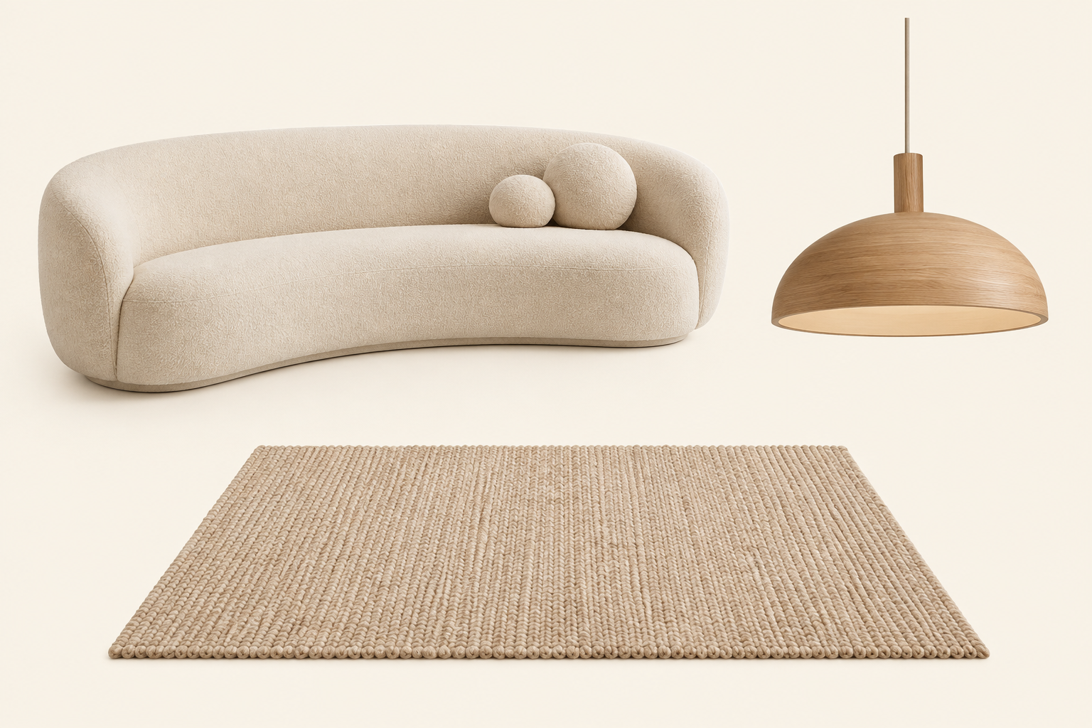
Interior design
workflow software.
THE CONNECTED PROJECT
Less admin. More time for design.
LIVING ROOM · CONCEPT BOARD
Connected product specifications across concept boards, the master budget, proposals, purchase orders, and invoices.
Follow one living room project, from the first presentation to the client invoice.
Illustrative project · Product images and specifications stay connected to the commercial work.
01 / 09
Notes:
Open with the project outcome. The audience will follow one illustrative Living room project from its existing presentation to the invoice.

Slide 2
Import your Canva or
PowerPoint presentation.
01 / IMPORT
Start with the presentation you already have.
Bring your existing presentation into Net Atelier. Then add and manage the product specifications for that project's concept board.
EXISTING PRESENTATION
LIVING ROOM · CONCEPT BOARD
Canva or PowerPoint
Net Atelier project
02 / 09
Notes:
Start with a presentation already designed in Canva or PowerPoint. Do not claim that import automatically extracts product data; Product Picker and the concept board create the structured records in the next step.

Slide 3

AI Product Picker
Web Browser Extension
02 / PRODUCT PICKER
Less manual entry. Faster product sourcing.
ADDED TO LIVING ROOM CONCEPT BOARD
Instantly add a product from a supplier or other website to your project's concept board, with its image, price, colour, specifications, and other listed details attached.
Oak pendant
SUPPLIER COST
CAD 420.00
COLOUR
Natural oak
CATEGORY
Lighting
SPECIFICATION
Pendant light · listed details attached
Illustrative product record
03 / 09
Notes:
Use the full product name on first mention. Product Picker adds the product to the correct project's concept board with available listed details attached, so the team does not retype them.

Slide 4
Present the concept.
The product details stay connected.
03 / CONCEPT BOARD
More confidence in client presentations.
Each product on the concept board retains its specifications and financial details for the team to budget, order, and invoice.
CLIENT PRESENTATION · LIVING ROOM
TEAM PRODUCT DETAILS
Oak pendant
Category: Lighting
Finish: Natural oak
Supplier cost: CAD 420.00
Markup: 40% · Margin: 28.6%
04 / 09
Notes:
The client sees the composed concept board. The team record retains the category, specification, supplier details, cost, markup, and margin. Do not imply that client presentations expose team margin.

Slide 5
The concept board populates
the master budget automatically.
04 / MASTER BUDGET
See your costs. Protect your margin.
Review product specifications, costs, custom markups, and margins. Break down the budget by room, category, or vendor.
LIVING ROOM · ILLUSTRATIVE FIGURES · CAD
Product | Category | Cost | Markup | Client price | Margin
Ivory sofa | Furniture | 2,100.00 | 40% | 2,940.00 | 28.6%
Oak pendant | Lighting | 420.00 | 40% | 588.00 | 28.6%
Sand rug | Textiles | 650.00 | 40% | 910.00 | 28.6%
Project total |  | 3,170.00 |  | 4,438.00 | 28.6%
Product images, specifications, and supplier details remain part of the master budget.
05 / 09
Notes:
Selected products populate the master budget. Explain that the financial examples are illustrative CAD figures. The pendant row is highlighted because it will change next.

Slide 6
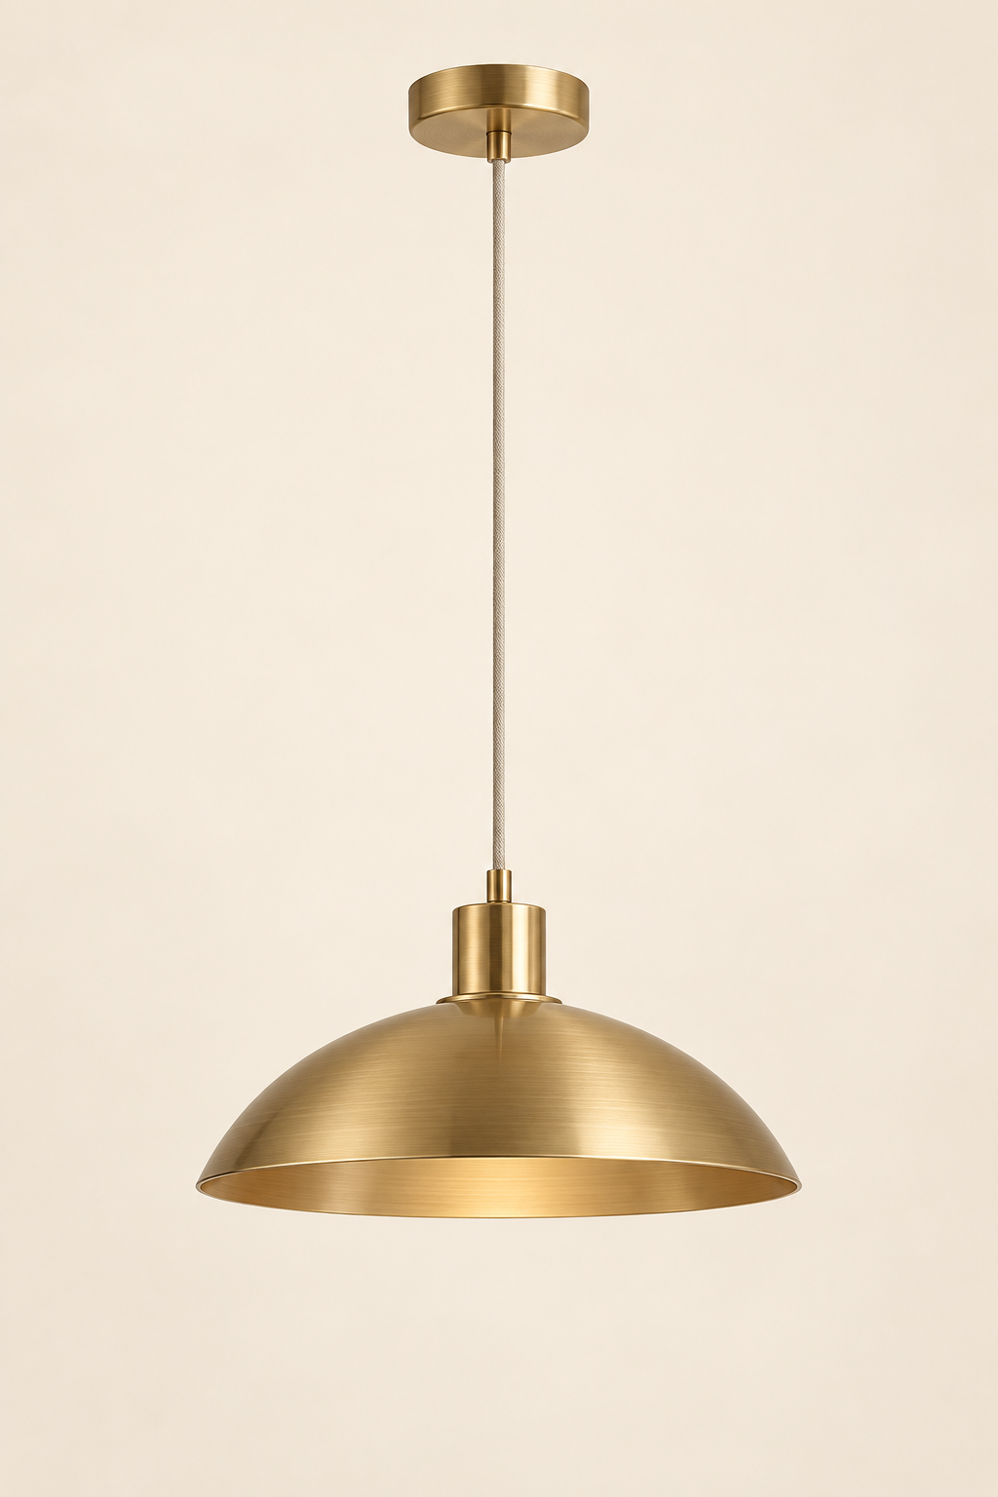
The client changes the pendant.
Update the specification once.
05 / SPECIFICATION CHANGE
Fewer pricing errors. Less retyping.
ORIGINAL
Linked records update from the revised specification
Oak
pendant
Concept board
Brass pendant and revised specifications
Natural oak
Supplier cost: CAD 420.00
Master budget
Pendant cost: 485.00 · Client price: 679.00
Linked draft documents
Revised product details and prices update automatically
REPLACEMENT
Brass
pendant
Brushed brass · CAD 485.00
Client-sent documents are never changed automatically. Net Atelier asks whether you want to update them.
06 / 09
Notes:
Be precise: linked draft documents update from the current project record. Documents already sent to a client are not changed automatically; Net Atelier asks whether the team wants to update them.

Slide 7
Create the draft purchase order
from the master budget.
06 / PURCHASE ORDER
Less admin when ordering from suppliers.
Use the product specifications and supplier costs already in the master budget. Review the draft purchase order before sending it to the supplier.
DRAFT PURCHASE ORDER · ILLUSTRATIVE EXCERPT
Example supplier
Living room · CAD · Excludes tax and delivery
Product | Specification | Qty | Unit cost | Line total
Brass pendant | Brushed brass | 1 | 485.00 | 485.00
Draft total |  |  |  | 485.00
Current product specification and supplier cost, ready for review.
07 / 09
Notes:
The draft purchase order starts from the current master budget, with the revised brass pendant and supplier cost. Creating a draft does not send the order or make a payment.

Slide 8
Create the client invoice
from the master budget.
07 / INVOICE
Know what is ordered, invoiced, and paid.
Use the current specifications and client prices to create the draft invoice. The project financial view shows purchase orders, issued invoices, and which invoices have been paid.
DRAFT INVOICE · ILLUSTRATIVE EXCERPT
PROJECT
FINANCIAL VIEW
Living room client
CAD · Excludes tax and delivery
Purchase orders
Product | Qty | Client price | Line total
Brass pendant | 1 | 679.00 | 679.00
Draft total |  |  | 679.00
What is ordered
Invoices issued
What is invoiced
Invoices paid
What has been paid
08 / 09
Notes:
The invoice uses the current client price from the master budget. The project financial view lets the team review purchase orders, issued invoices, and paid invoices. Do not claim real-time budget-versus-actual reporting.

Slide 9

Less admin.
More time for design.
START YOUR TRIAL
Try it with your next project.
Start your 14-day free trial.
Card required · Cancel anytime
$49/month for one user
$9/month per additional user
Scan to start your free trial
net-atelier.com/primavera
09 / 09
Notes:
Invite the audience to start a 14-day free trial with one active project. State the terms accurately: card required, cancel anytime. Pricing is $49/month for one user and $9/month per additional user.

