Slide 1

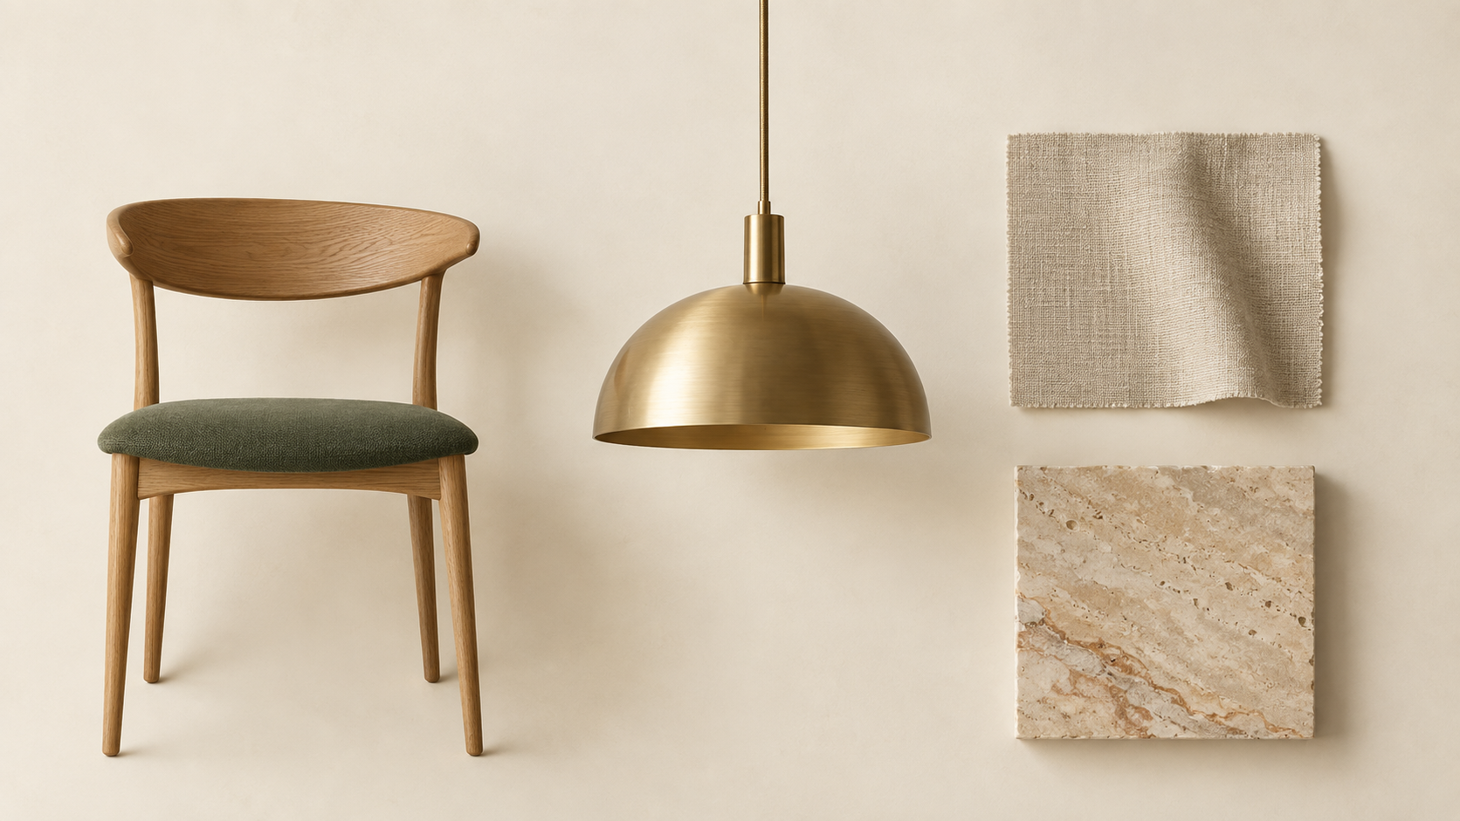
Design the room.
Keep the project in step.
ONE CLIENT PROJECT
Selections, specifications, budgets, and draft documents stay connected to the same client project.
01 / 10
Notes:
Introduce Net Atelier as the connected project system for an interior design studio. The deck follows a project from concept board through budgets and draft commercial documents.

Slide 2

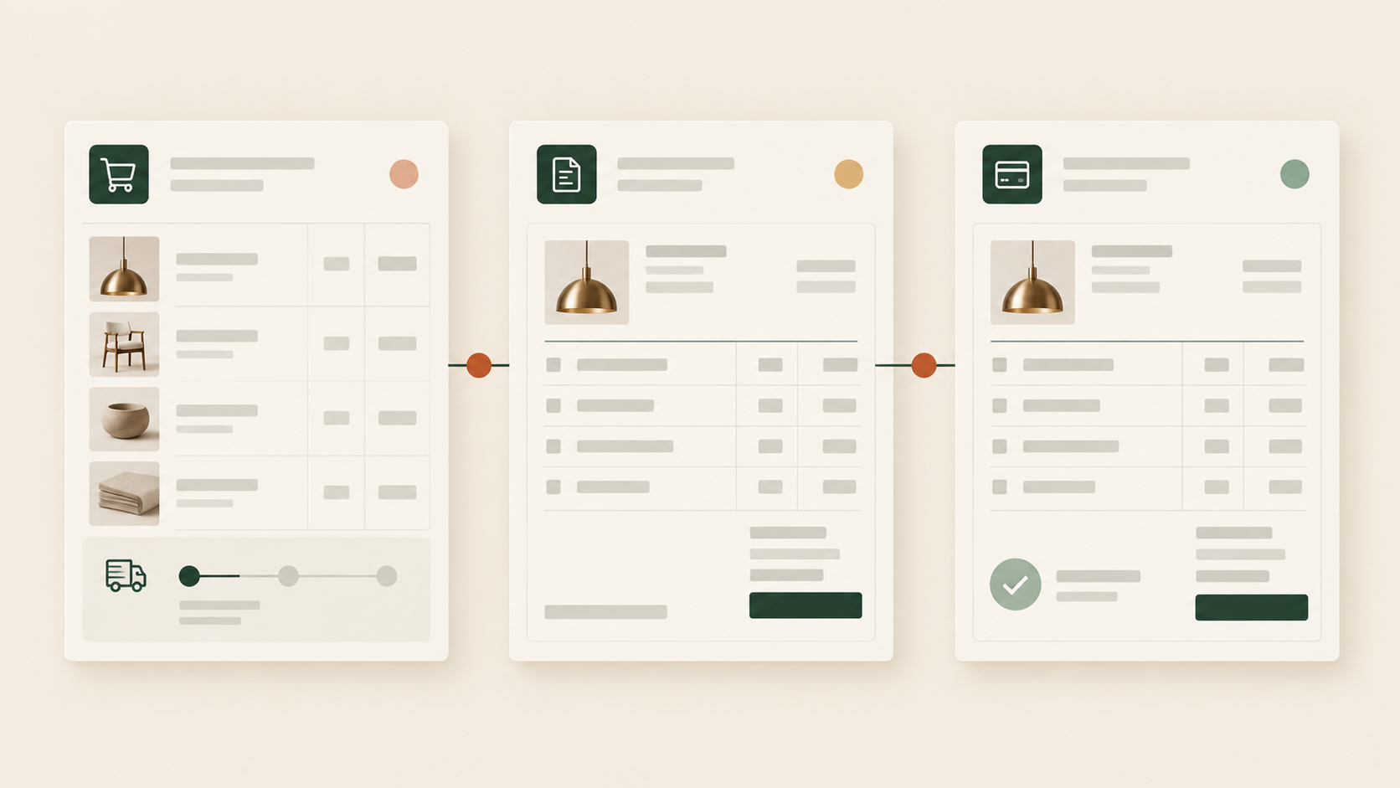
A changed selection should not mean a night of retyping.
THE COST OF DISCONNECTED WORK
Without a shared project record, the board, budget, proposal, purchase order, and invoice can each carry a different version of the product.
02 / 10
Notes:
Explain the market pain in concrete terms: separate boards, spreadsheets, supplier documents and invoices force people to reconcile the same change. Net Atelier connects the project record so the team starts the next task from current information.

Slide 3
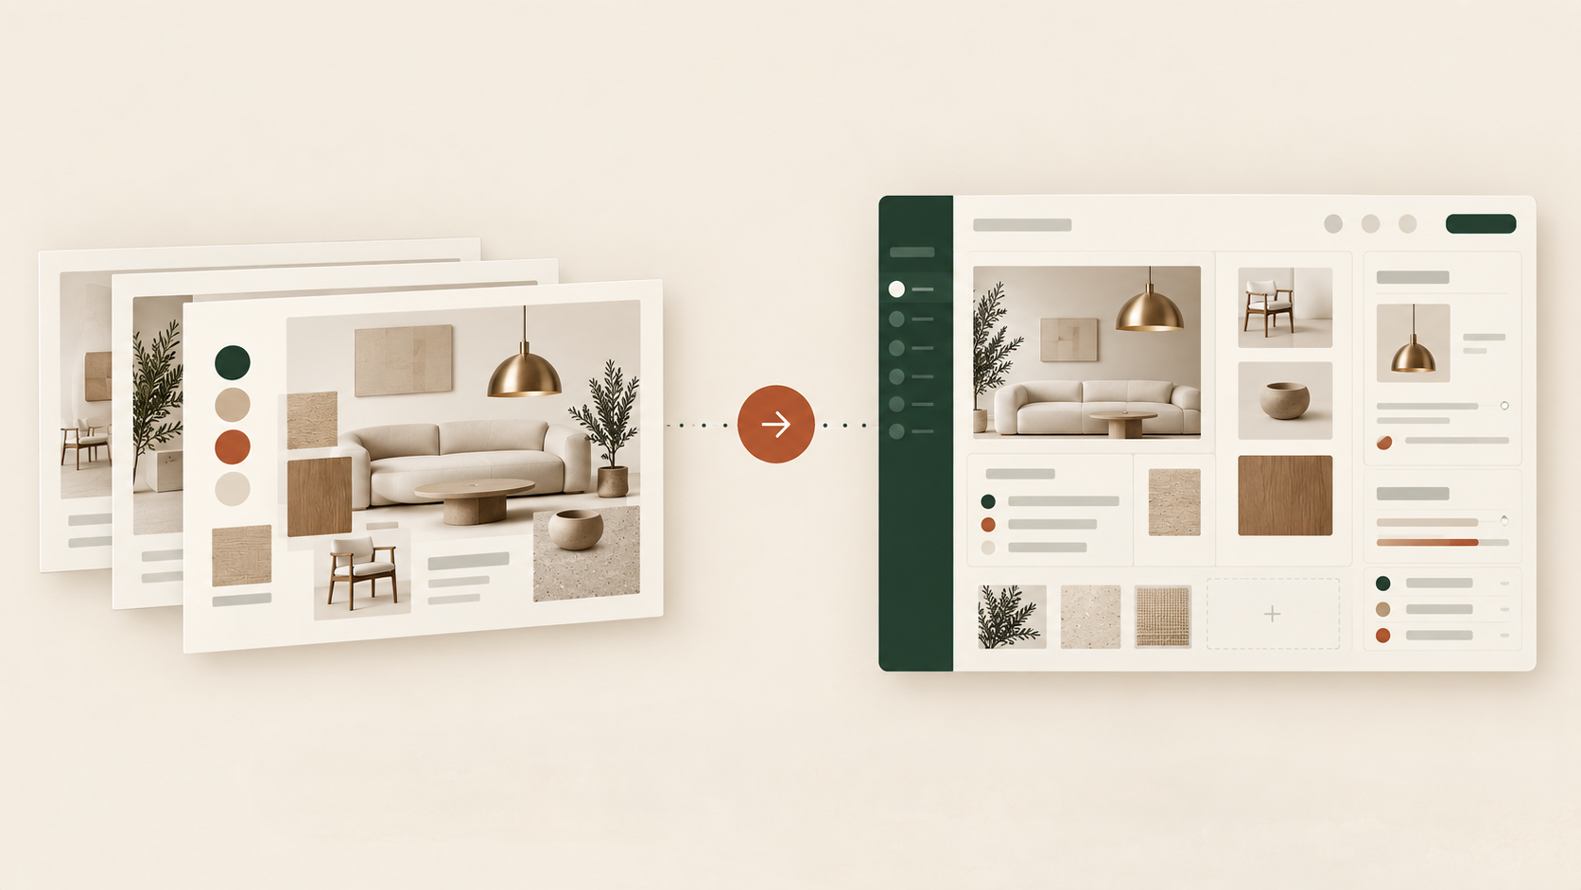
Keep the board.
Make it part of the project.
IMPORT EXISTING WORK
Import your existing PowerPoint or Canva board, then use it as the starting point for the connected project work.
03 / 10
Notes:
Start with familiar presentation work. A project can hold multiple concept boards, including boards brought from tools the studio already uses.

Slide 4
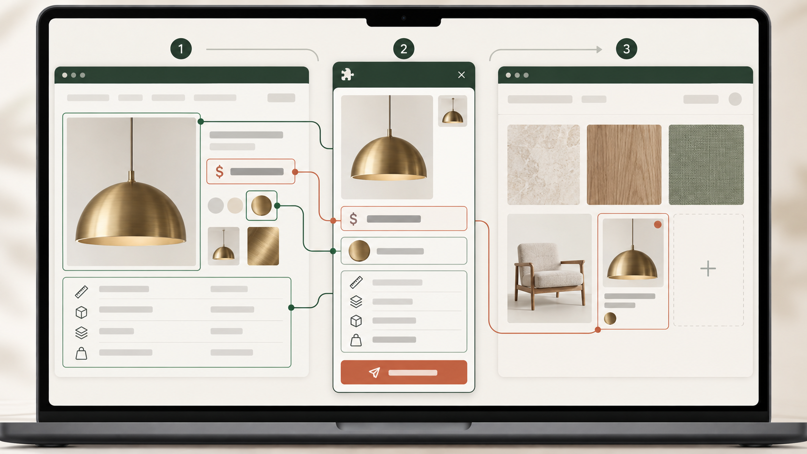
Bring the supplier page into the concept board.
PRODUCT PICKER
Use Product Picker to bring the available image, price, colour, specifications, and other listed details into a structured product card.
04 / 10
Notes:
Use the Product Picker browser image, not the earlier generic selection image. Available listed details arrive in the right client project and concept board.

Slide 5
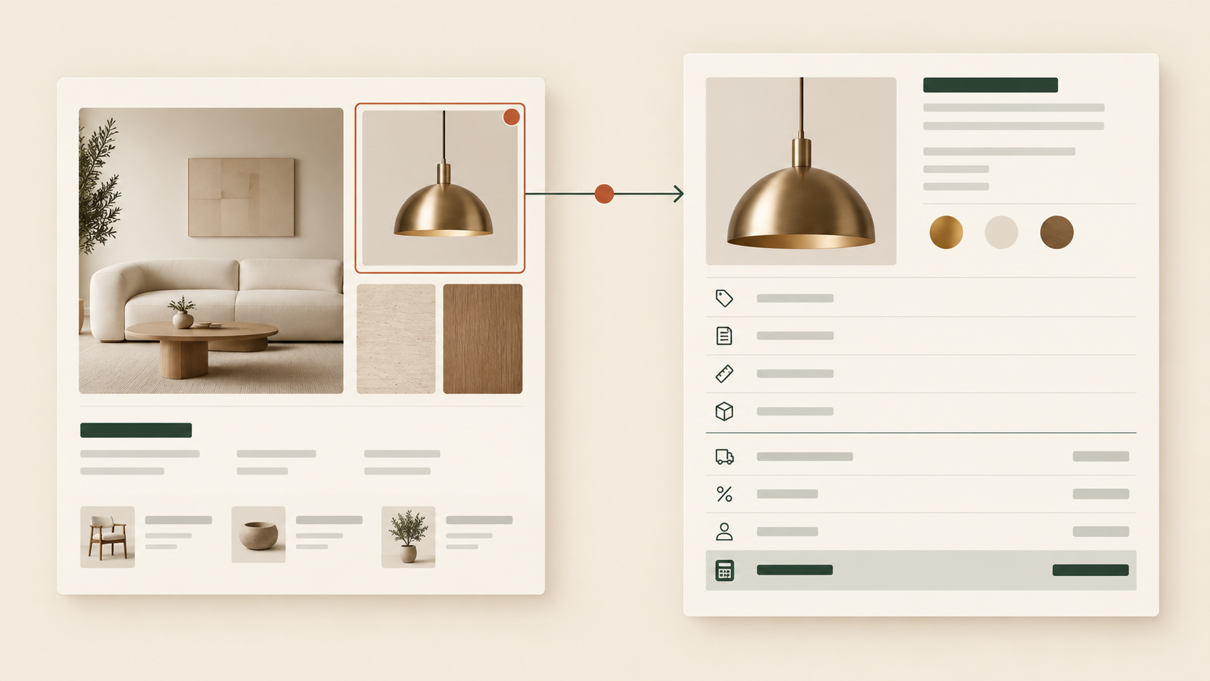
Give every room its own place to take shape.
CONCEPT BOARDS
Create a concept board for each room or direction, with its selections and budget kept alongside the design work.
05 / 10
Notes:
Client project at the top, multiple concept boards beneath it, individual board budgets, and a master budget that combines them into the project system of record.

Slide 6
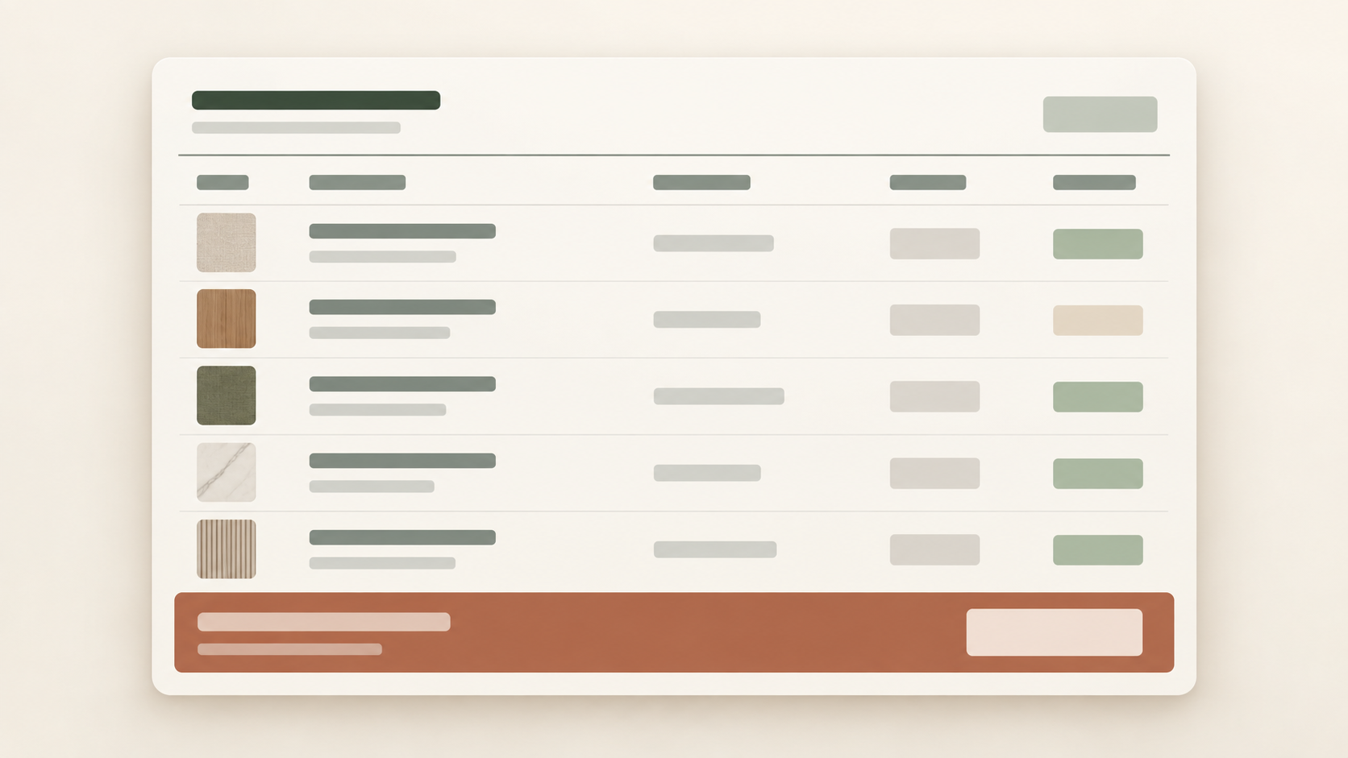
Know where the project stands, not just each room.
MASTER BUDGET
The master budget brings the products and individual board budgets into one project-level financial view.
06 / 10
Notes:
The master budget is the ultimate project-level system of record. It combines individual concept-board budgets so the studio can manage the project as one commercial whole.

Slide 7
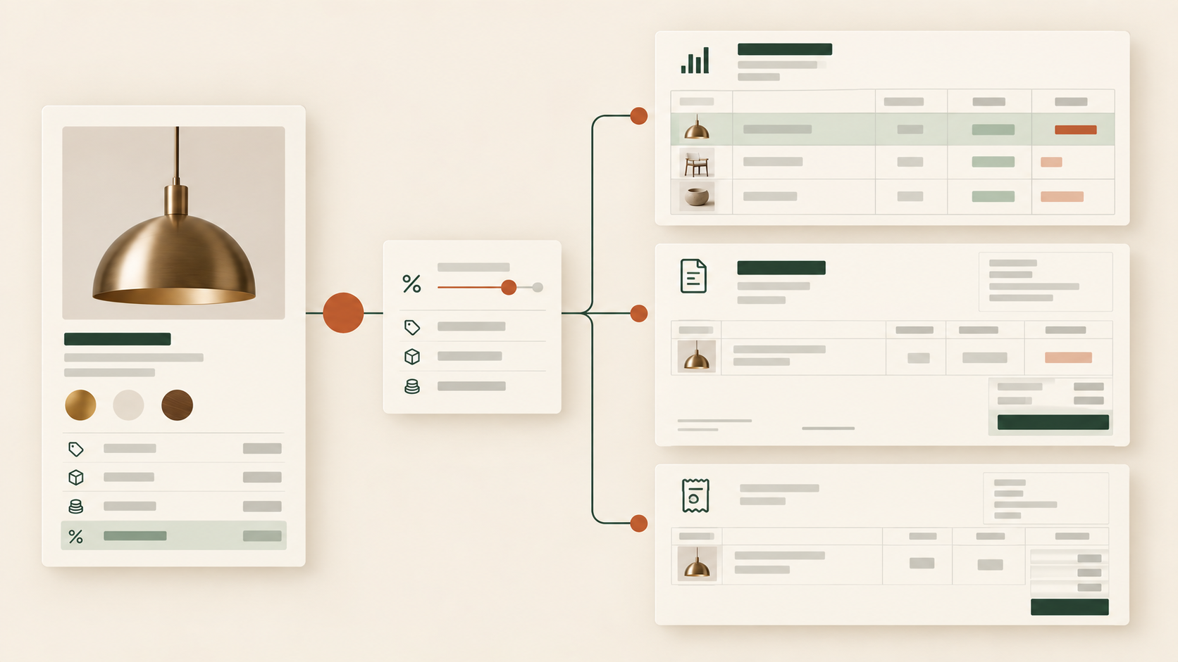
Make the revision once.
Carry the right detail forward.
WHEN A SELECTION CHANGES
The linked budget, affected draft proposal, draft purchase order, and draft invoice update from the same record.
07 / 10
Notes:
Use an example such as a client changing a pendant or fabric. Current project records and draft documents reflect the change; client-sent documents require confirmation.

Slide 8
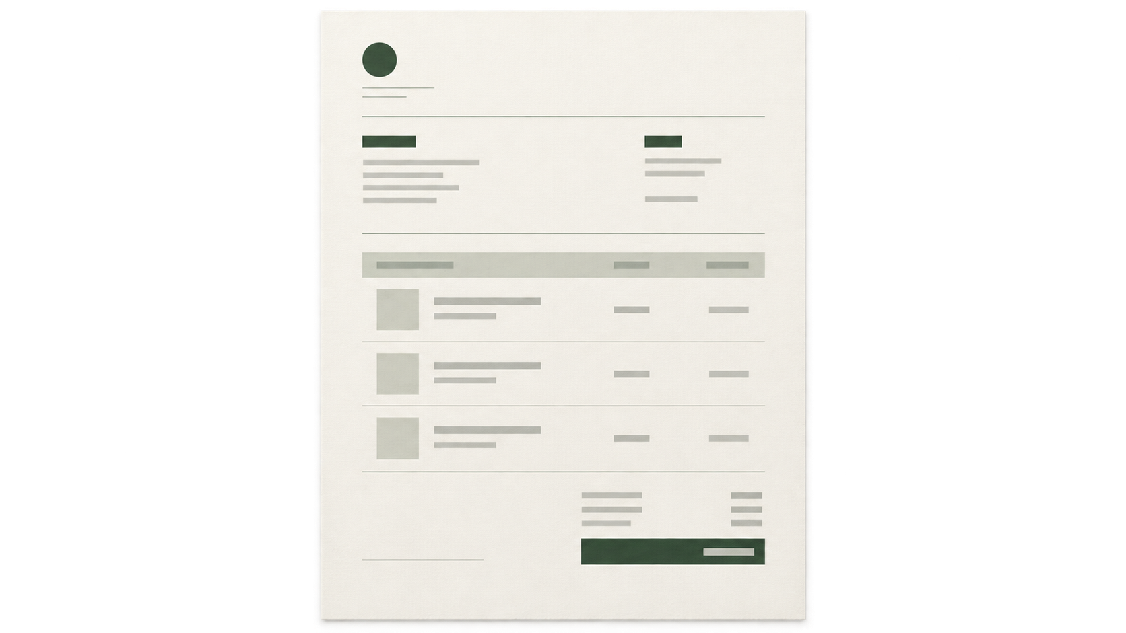
Keep the supplier order close to the specification.
DRAFT PURCHASE ORDER
The draft purchase order begins with the supplier, product, specification, and commercial details already connected to the project.
08 / 10
Notes:
The missing purchase-order image is now a primary visual. Emphasize that it begins as a draft based on the current project record.

Slide 9
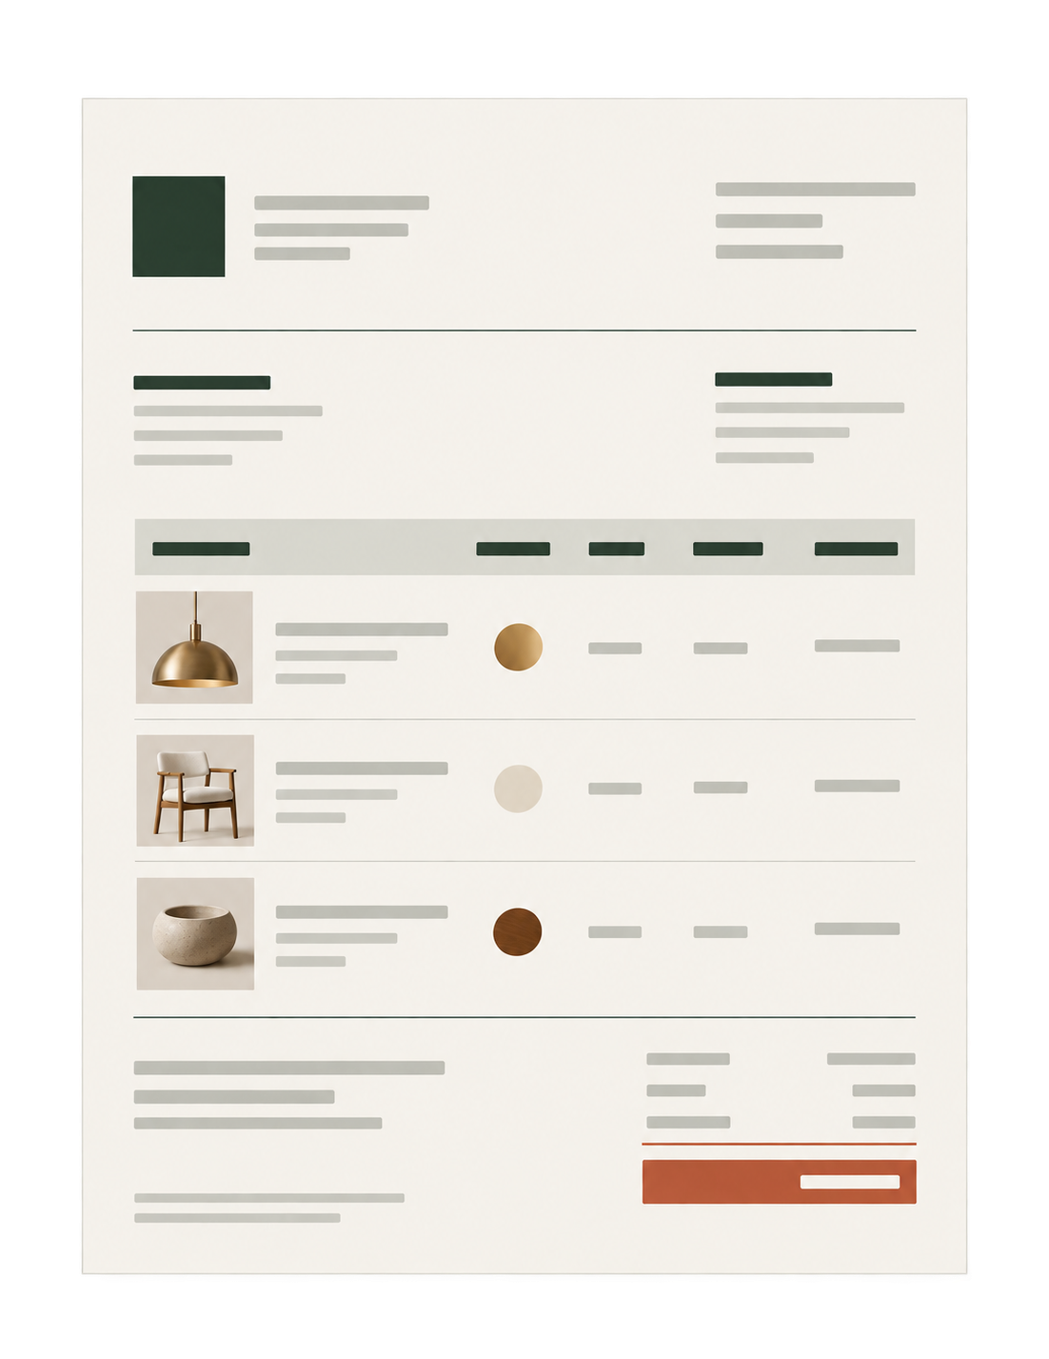
Keep the client invoice close to the project.
DRAFT INVOICE
The draft invoice begins with the selected products and financial context already connected in the client project.
09 / 10
Notes:
The invoice slide now uses the dedicated client billing-document composition from the downloaded S3 image set. The editable slide copy names the draft invoice and financial view.

Slide 10

See what changes when the project record keeps up with the design.
PRIMAVERA OPEN HOUSE
Start your 14-day free trial. Card required. Cancel anytime.
$49/month for one user. Each additional user is $9/month.
Scan to start your trial
net-atelier.com/primavera
10 / 10
Notes:
Close with the QR and an invitation to use one live client project. Repeat the 14-day trial terms and accurate pricing.

